Slide 1
College and Career Readiness

Slide 2
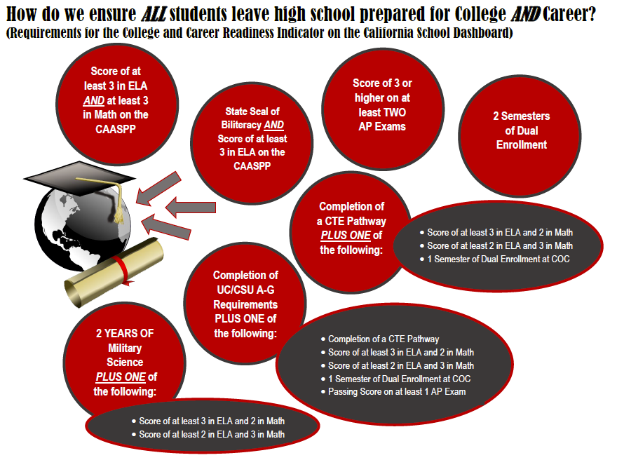
What does it mean to be College and Career Ready?
Notes:
Fayanne - 3 minutes
Need to update this to include Seal of Biliteracy and Leadership/Military Science

Slide 3
Why is College and Career Readiness important?
Notes:
Cut at 2:35

Slide 4
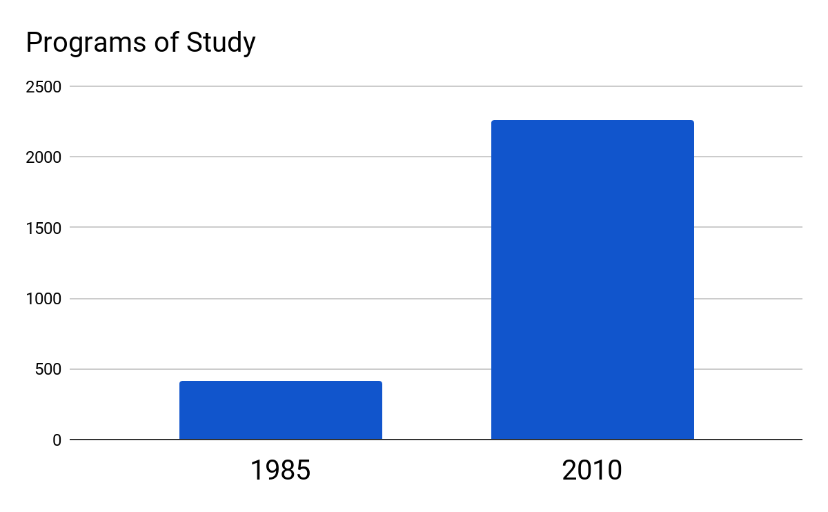
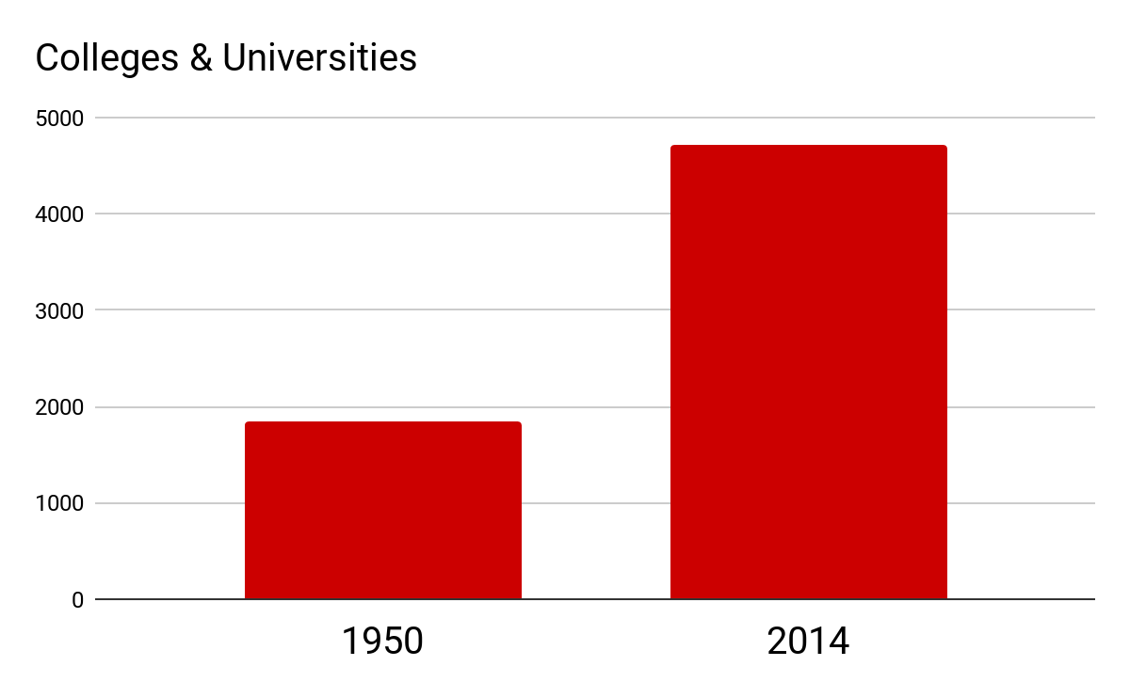
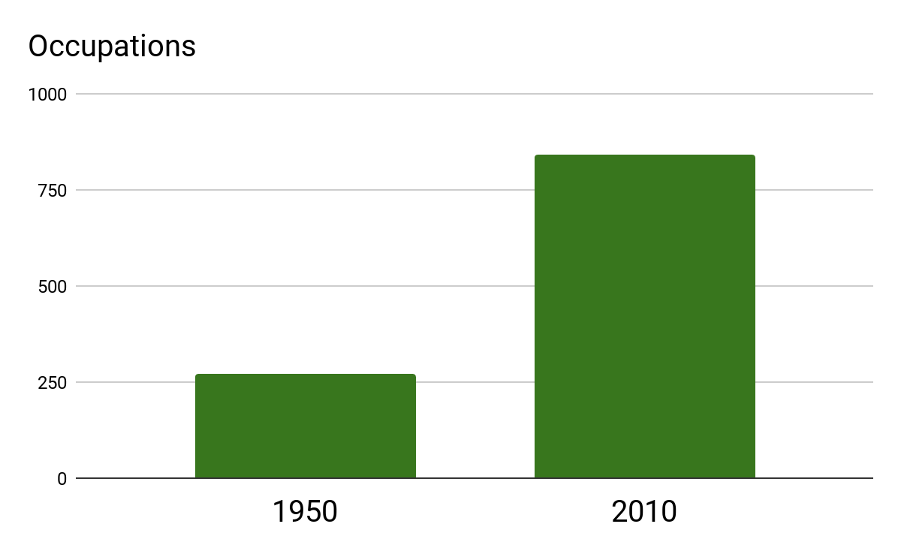
Why is College and Career Readiness important?
Post secondary programs of study quintupled between 1985 and 2010
Number of colleges & universities more than doubled between
1950 and 2014
Number of occupations tripled between
1950 and 2010
(source Georgetown University)
Notes:
Kari/Panel - 7 minutes

Slide 5
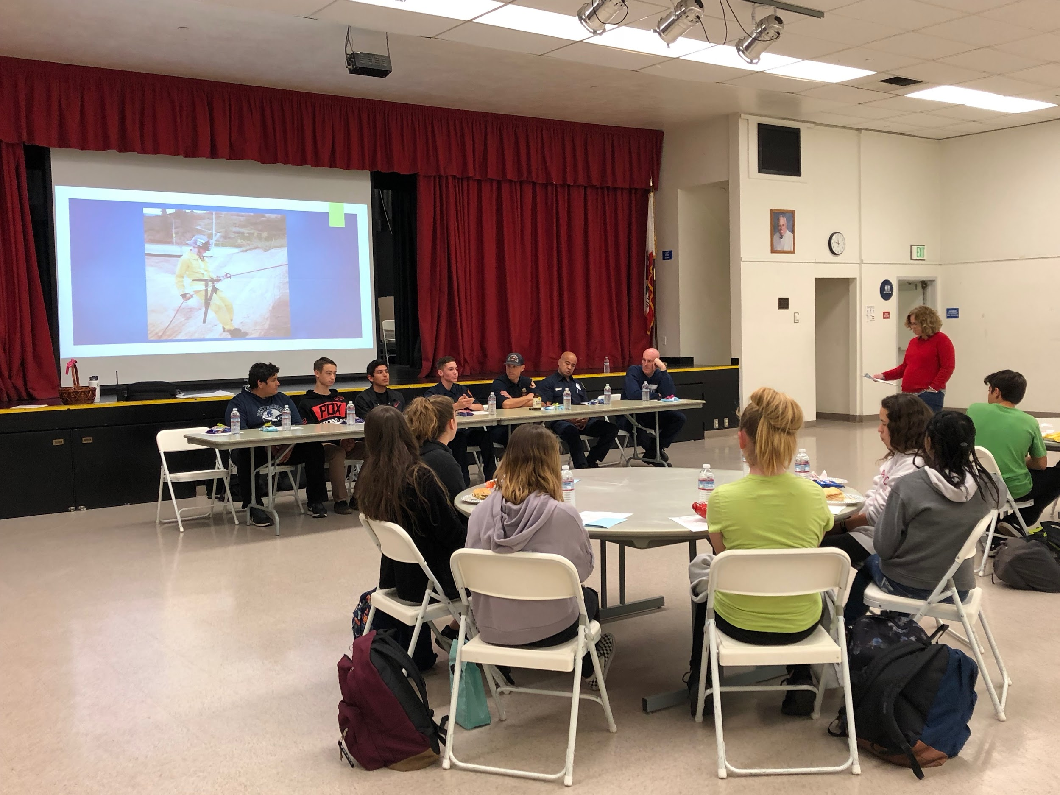
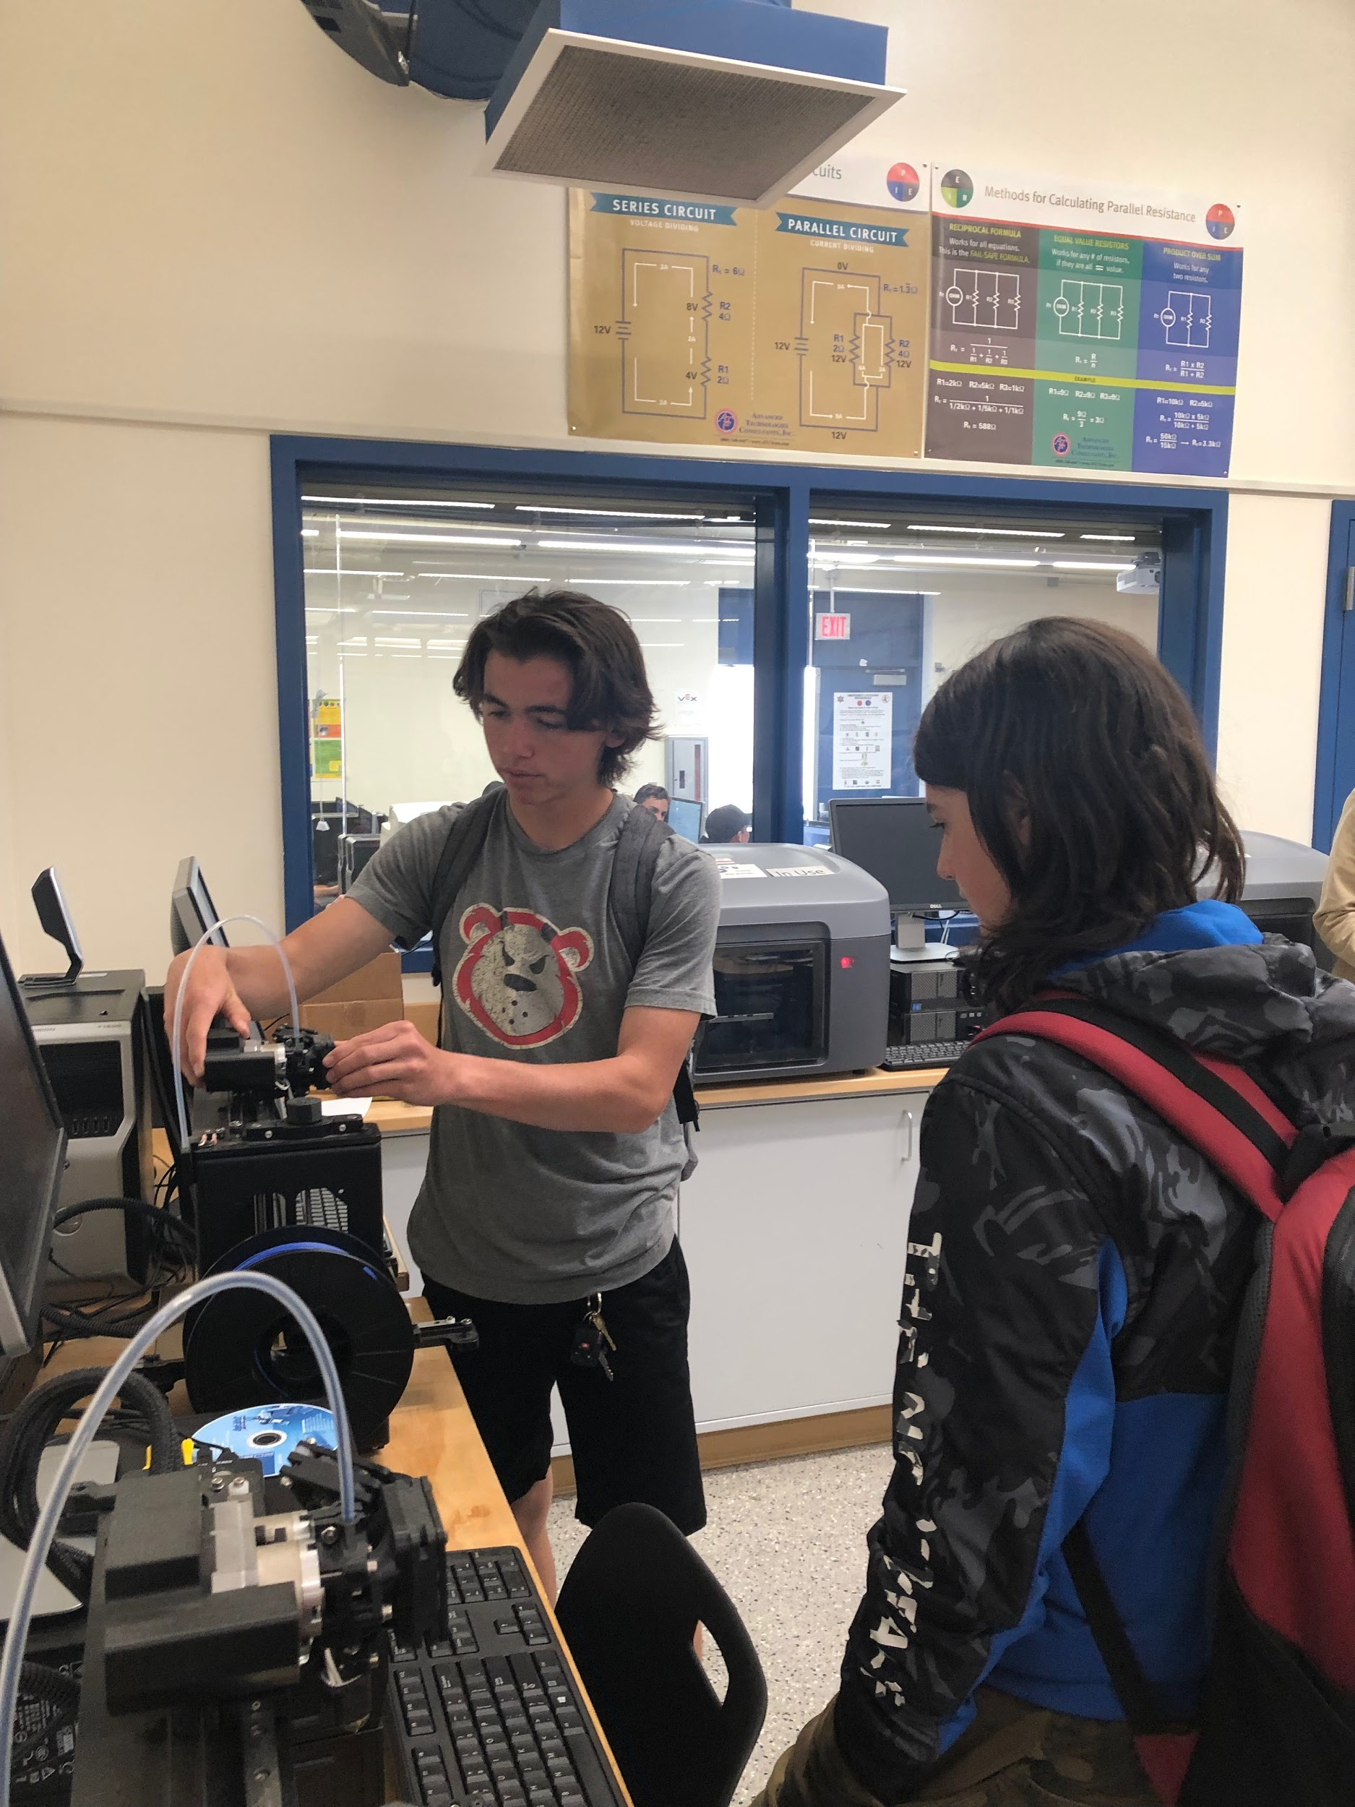
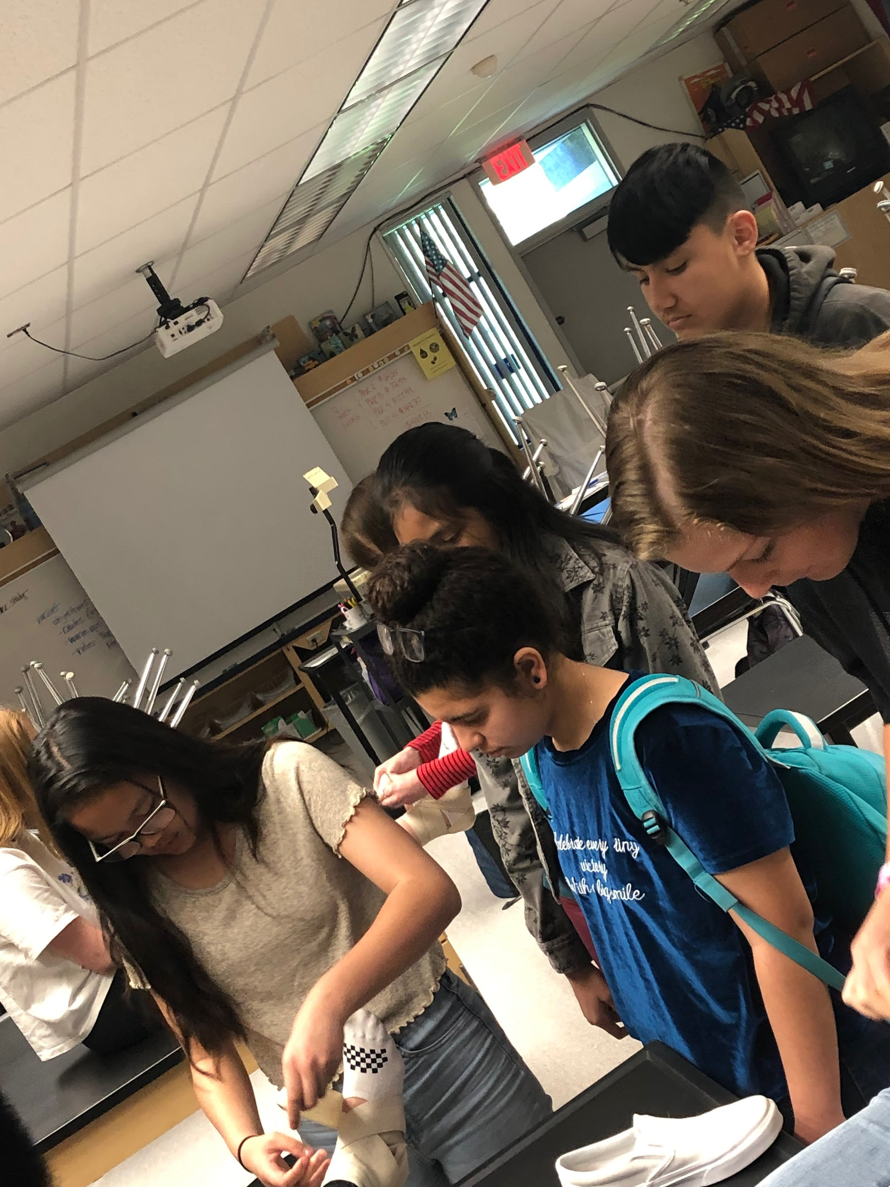
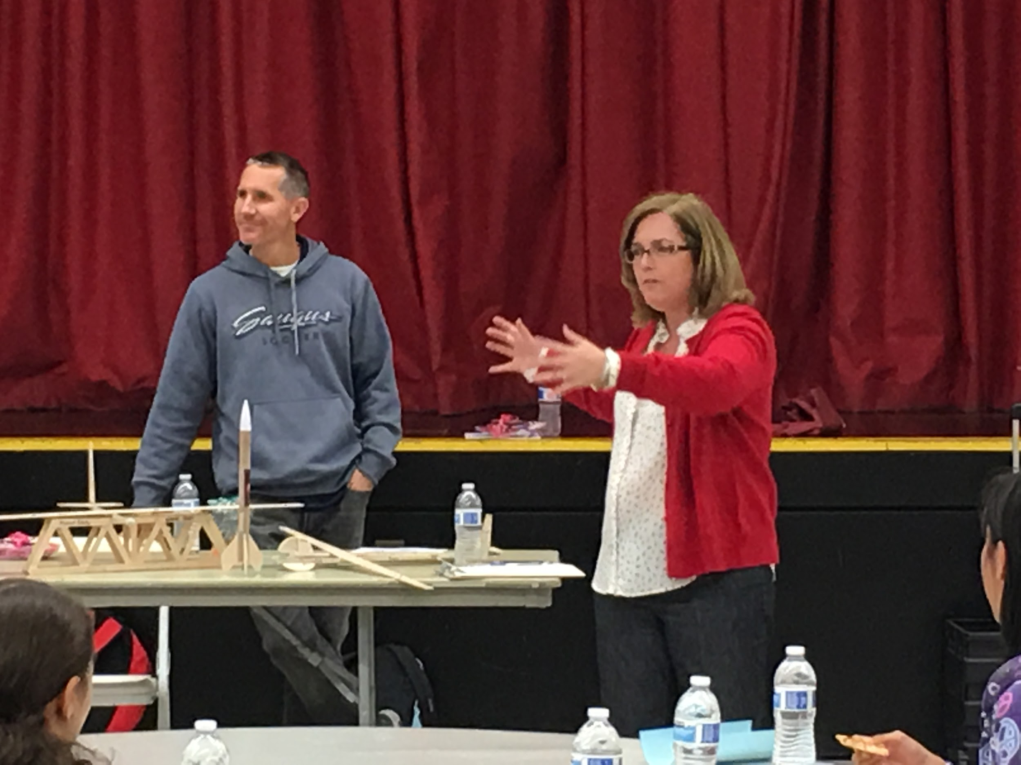
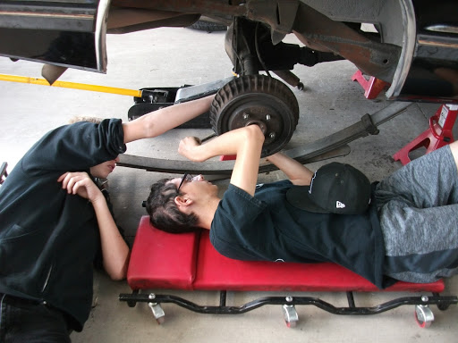
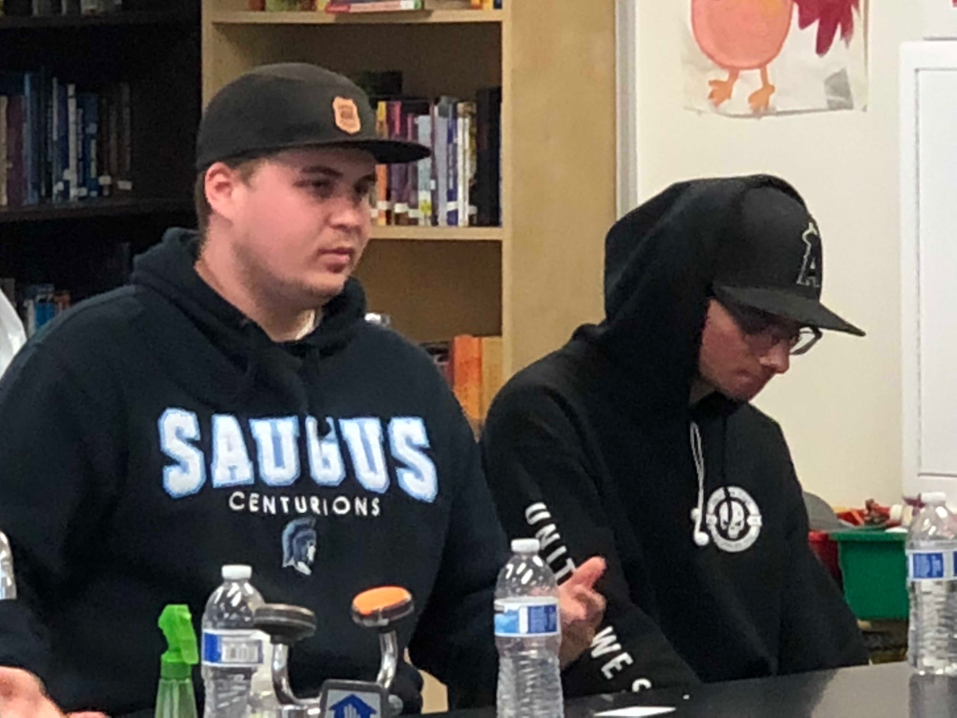
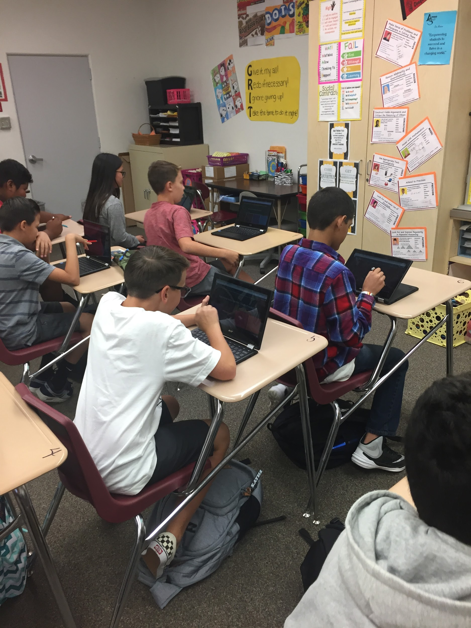
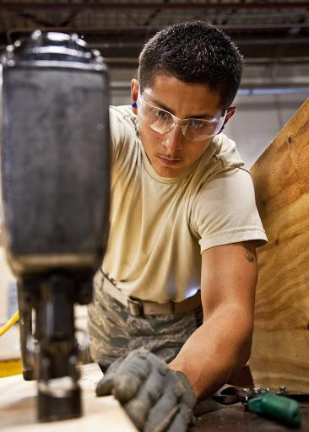
How are we preparing students at Arroyo Seco?
Moving our kids from Exposure
To Engagement
Notes:
Jesse - 5 minutes
What else can we add?

Slide 6
What opportunities are available at Saugus?
College and Career Pathways
Administration of Justice & Forensic Science
Animal Science
Automotive Technology
Business: Sales & Marketing
Computer Science
Construction Technology
Cyber Security
Dental Assisting
Education
Design, Visual and Media Arts
Engineering & Adv MFGT
Film & Video Production
Fire Science/Emergency Medical Response
Hospitality
Pharmacy Tech
Sports Medicine
Notes:
Kari - 3 minutes
Insert Pathway options

Slide 7
How can you help prepare your students for College and Career?
Tips for 7th Grade Parents
Naviance
Encourage attendance at Pathway Panels
Parent University
Activites, Internships, Volunteering to build skills necessary for success
Mr. Marshall : jwmarshall@hartdistrict.org
Tips for 8th Grade Parents
Naviance
Career Pathway Courses
Career Pathway Summer Exploratories
Parent University
Activites, Internships, Volunteering to build skills necessary for success
Mrs. Dahlquist : kdahlquist@hartdistrict.org
Notes:
Jesse - 3 minutes

Slide 8
Please join us for
Q & A at our College and Career Table outside!!!!!!!
Speak to Mrs. Dahlquist, Mr. Marshall and Mrs. Bakoo about specific pathways offered through Saugus
Pick up handouts for Career Pathways, Parent University and Summer Exploratories.
Get information on volunteers needed for 8th Grade Showcase.
Notes:
Fayanne - 1 minute

